Slide 1
Machine Learning for Neuroscience
Applications in neuroscience and neuroscience inspired models
Payam Barnaghi
Department of Brain Sciences
Imperial College London
January 2024
Notes:
1

Slide 2
Neuroscience and AI
Neuroscience provides a rich source of inspiration for new types of algorithms and architectures.
This is often independent of and complementary to the mathematical and logic-based methods and ideas that have largely dominated traditional approaches to AI.
Source: Hassabis D, Kumaran D, Summerfield C, Botvinick M. Neuroscience-Inspired Artificial Intelligence. Neuron. 2017

Slide 3
Neuroscience in ML
Neuroscience could help to provide a systems neuroscience-level view of the brain.
It can help to view the network, architecture, functions, and representations that the brain utilises.
The precise mechanisms by which the processes/interactions are physically realised in a biological substrate are often less relevant at the implementation level (of AI models).
Source: Hassabis D, Kumaran D, Summerfield C, Botvinick M. Neuroscience-Inspired Artificial Intelligence. Neuron. 2017

Slide 4

Transferrable ideas from neuroscience
By focusing on the computational and algorithmic levels, we can obtain transferrable insights into general mechanisms of brain function while leaving room to accommodate the distinctive opportunities and challenges that arise when building intelligent machines in silico.
Source: Hassabis D, Kumaran D, Summerfield C, Botvinick M. Neuroscience-Inspired Artificial Intelligence. Neuron. 2017

Slide 5

Deep learning
For example, biological considerations informed the development of successful regularisation schemes that support generalisation beyond training data.
One such scheme, in which only a subset of units participate in the processing of a given training example (‘‘dropout’’), was motivated by the stochasticity that is inherent in biological systems populated by neurons that fire with Poisson-like statistics (Hinton et al., 2012).
Source: Hassabis D, Kumaran D, Summerfield C, Botvinick M. Neuroscience-Inspired Artificial Intelligence. Neuron. 2017

Slide 6
Deep learning and biological systems
In both biological and artificial systems, successive non-linear computations transform raw visual input into an increasingly complex set of features, permitting object recognition that is invariant to transformations of pose, illumination, or scale.
Source: Hassabis D, Kumaran D, Summerfield C, Botvinick M. Neuroscience-Inspired Artificial Intelligence. Neuron. 2017

Slide 7
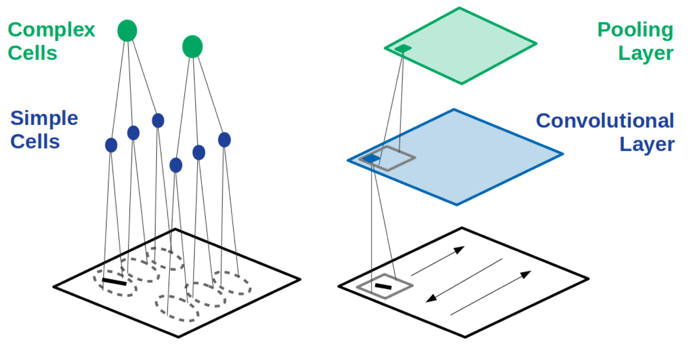
CCNs and visual cortex
Hubel and Wiesel discovered that simple cells (left, blue) have preferred locations in the image (dashed ovals) wherein they respond most strongly to bars of particular orientation. Complex cells (green) receive input from many simple cells and thus have more spatially invariant responses.
Source: Grace W. Lindsay, Gatsby Unit, UCL, https://arxiv.org/pdf/2001.07092.pdf

Slide 8
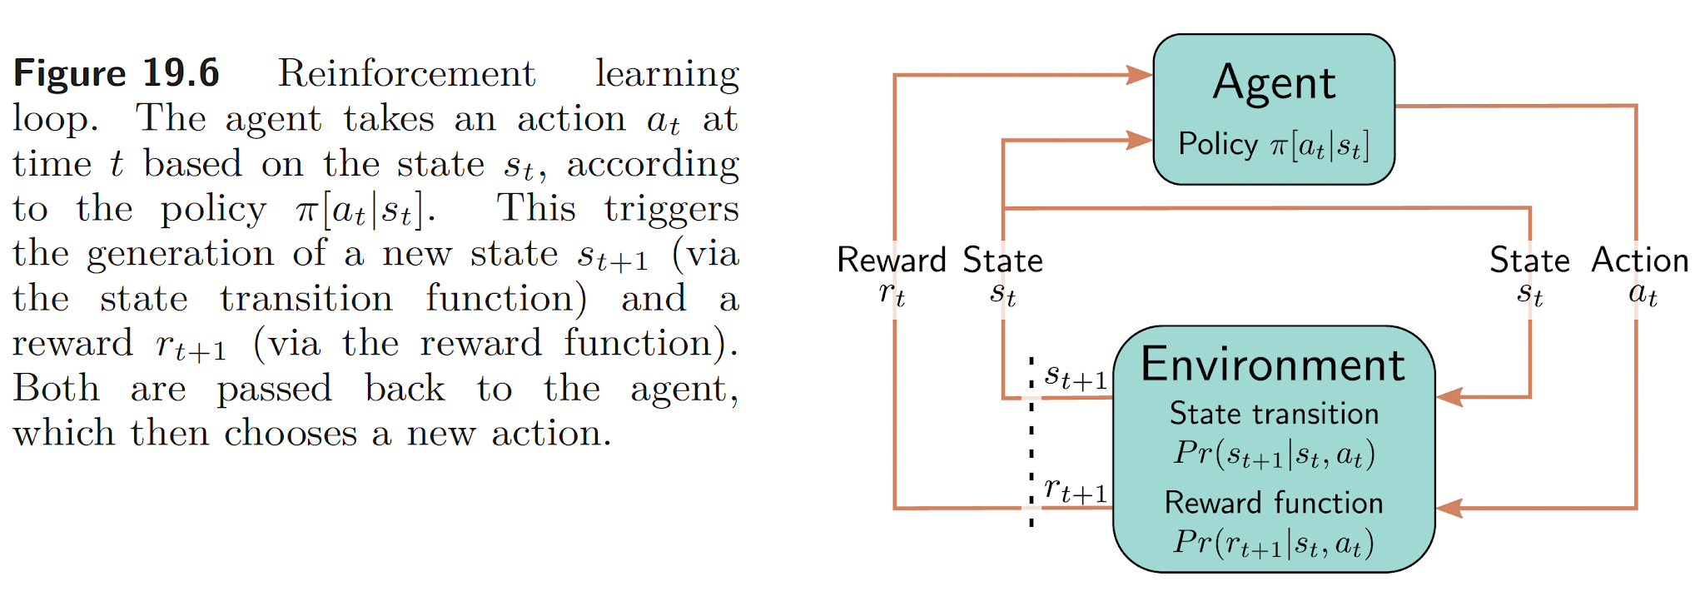

Reinforcement learning (RL)
Source: Understanding Deep Learning, Simon J.D. Prince, MIT Press.

Slide 9
Reinforcement learning
Reinforcement learning methods address the problem of how to maximise future reward by mapping states in the environment to actions and are among the most widely used tools in AI research (Sutton and Barto, 1998).
RL methods were originally inspired by research into animal learning. In particular, the development of temporal-difference (TD) methods, a critical component of many RL models, was inextricably intertwined with research into animal behaviour in conditioning experiments.
Source: Hassabis D, Kumaran D, Summerfield C, Botvinick M. Neuroscience-Inspired Artificial Intelligence. Neuron. 2017

Slide 10
Reinforcement learning
Examples of neuroscience-informed RL models include TD methods and related techniques have gone on to supply the core technology for recent advances in AI, ranging from robotic control (Hafner and Riedmiller, 2011) to expert play in backgammon (Tesauro, 1995) and Go (Silver et al., 2016).
Source: Hassabis D, Kumaran D, Summerfield C, Botvinick M. Neuroscience-Inspired Artificial Intelligence. Neuron. 2017

Slide 11
Attention-based models
The brain does not learn by implementing a single, global optimisation principle within a uniform and undifferentiated neural network (Marblestone et al., 2016).
Biological brains are modular, with distinct but interacting subsystems underpinning key functions such as memory, language, and cognitive control (Anderson et al., 2004; Shallice, 1988).
One illustrative example is recent AI work on attention. Up until quite lately, most CNN models worked directly on entire images or video frames, with equal priority given to all image pixels at the earliest stage of processing. The primate visual system works differently.
Source: Hassabis D, Kumaran D, Summerfield C, Botvinick M. Neuroscience-Inspired Artificial Intelligence. Neuron. 2017

Slide 12
CNNs and attention
Rather than processing all input in parallel, visual attention shifts strategically among locations and objects, centering processing resources and representational coordinates on a series of regions in turn (Koch and Ullman, 1985; Moore and Zirnsak, 2017; Posner and Petersen, 1990).
Detailed neurocomputational models have shown how this piecemeal approach benefits behaviour, by prioritizing and isolating the information that is relevant at any given moment (Olshausen et al., 1993; Salinas and Abbott, 1997).
One such network was able to use this selective attentional mechanism to ignore irrelevant objects in a scene, allowing it to perform well in challenging object classification tasks in the presence of clutter (Mnih et al., 2014).
Source: Hassabis D, Kumaran D, Summerfield C, Botvinick M. Neuroscience-Inspired Artificial Intelligence. Neuron. 2017

Slide 13
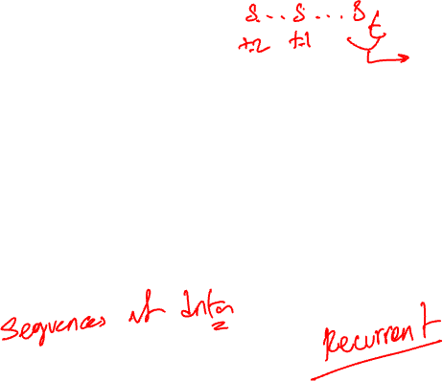
Working memory
Human intelligence is characterised by a remarkable ability to maintain and manipulate information within an active store, known as working memory, which is thought to be instantiated within the prefrontal cortex and interconnected areas (Goldman-Rakic, 1990).
Classic cognitive theories suggest that this functionality depends on interactions between a central controller (‘‘executive’’) and separate, domain-specific memory buffers (e.g., visuo-spatial sketchpad) (Baddeley, 2012).
Source: Hassabis D, Kumaran D, Summerfield C, Botvinick M. Neuroscience-Inspired Artificial Intelligence. Neuron. 2017

Slide 14
Continual learning
Intelligent agents must be able to learn and remember many different tasks that are encountered over multiple timescales.
Both biological and artificial agents must thus have a capacity for continual learning, that is, an ability to master new tasks without forgetting how to perform prior tasks (Thrun and Mitchell,1995). While animals appear relatively adept at continual learning, neural networks suffer from the problem of catastrophic forgetting (French, 1999; McClelland et al., 1995).
Source: Hassabis D, Kumaran D, Summerfield C, Botvinick M. Neuroscience-Inspired Artificial Intelligence. Neuron. 2017

Slide 15
Neuroimaging and continual learning
In neuroscience, advanced neuroimaging techniques (e.g., two-photon imaging) now allow dynamic in vivo visualisation of the structure and function of dendritic spines during learning, at the spatial scale of single synapses (Nishiyama and Yasuda, 2015).
This approach can be used to study neocortical plasticity during continual learning (Cichon and Gan, 2015; Hayashi-Takagi et al., 2015; Yang et al., 2009).
Source: Hassabis D, Kumaran D, Summerfield C, Botvinick M. Neuroscience-Inspired Artificial Intelligence. Neuron. 2017

Slide 16
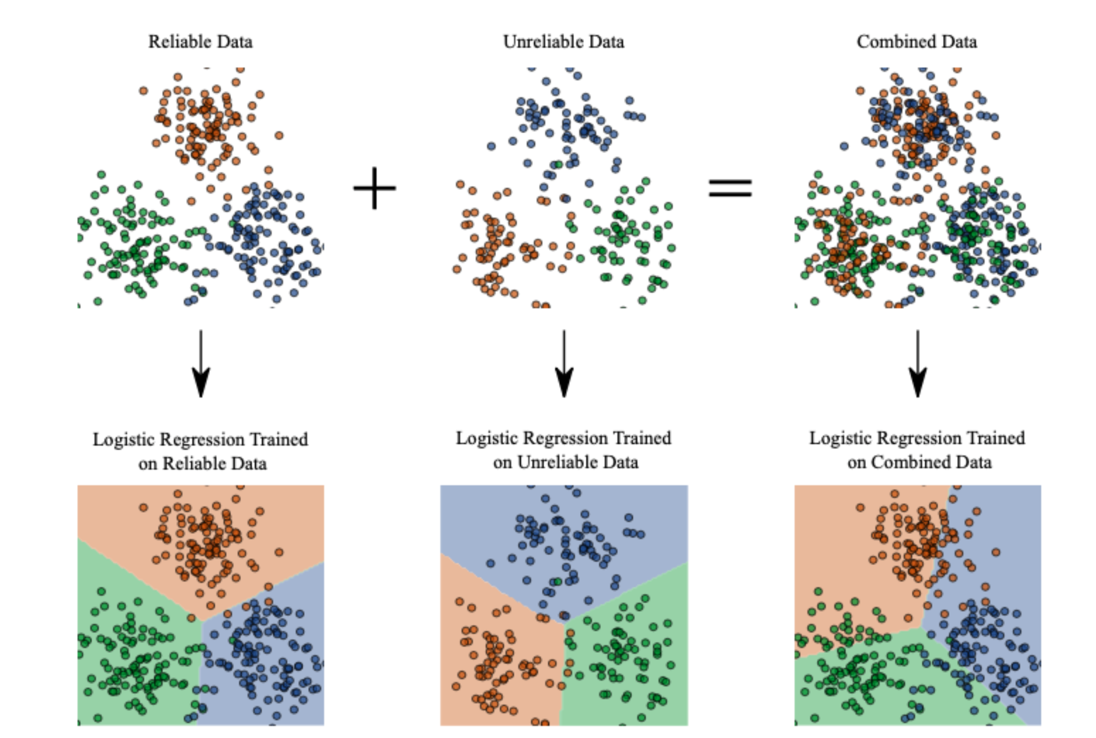
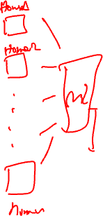
Neuroplasticity and machine learning models
A. Capstick, F. Palermo, P Barnaghi, https://arxiv.org/pdf/2212.02895.pdf
https://github.com/alexcapstick/LossAdaptedPlasticity

Slide 17
AI in neuroscience
Neuroimaging data analysis
Behaviour and large population data analysis
Computational models and simulations
Graph and network analysis
Fusion models and multimodal models for predictions/risk assessments
An interesting read, How AI and neuroscience drive each other, https://www.nature.com/articles/d41586-019-02212-4

Slide 18
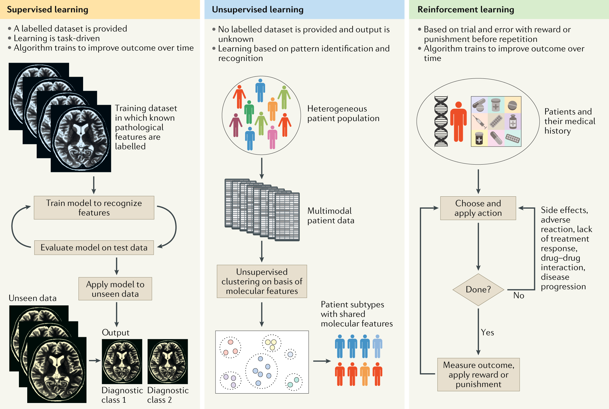

Applications of ML to diagnosis and treatment of neurodegenerative diseases
Source : Myszczynska, M.A., Ojamies, P.N., Lacoste, A.M.B. et al. Applications of machine learning to diagnosis and treatment of neurodegenerative diseases. Nat Rev Neurol16, 440–456 (2020).

Slide 19
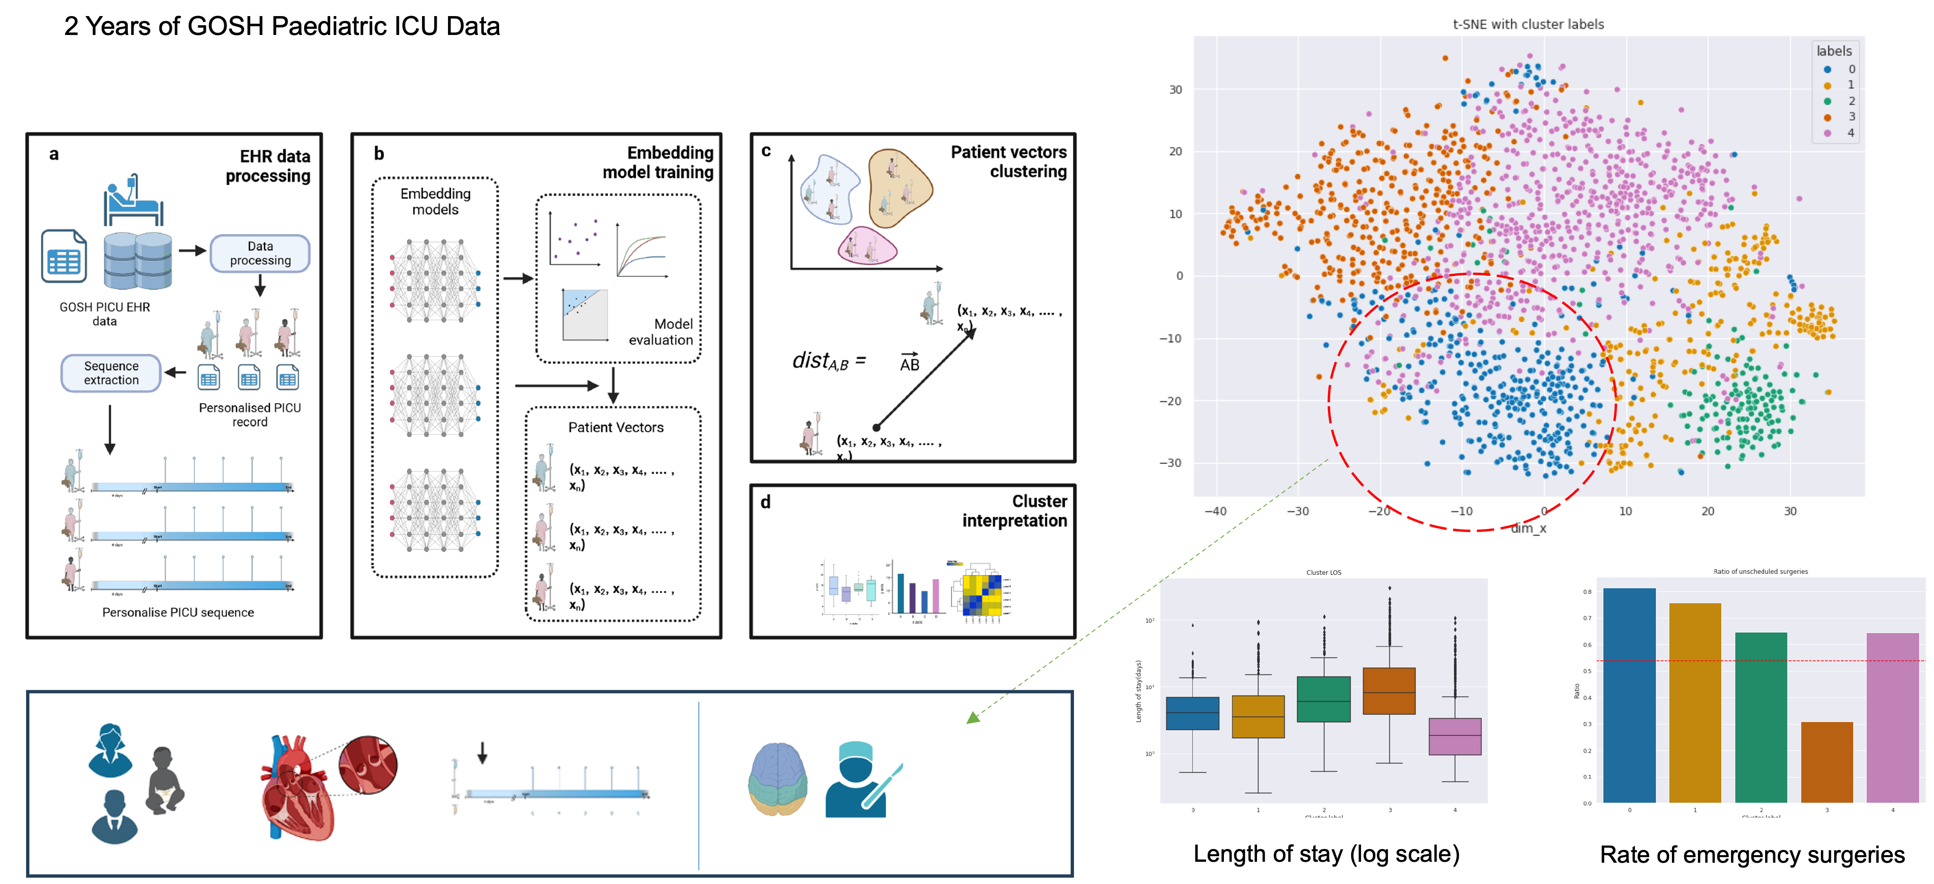
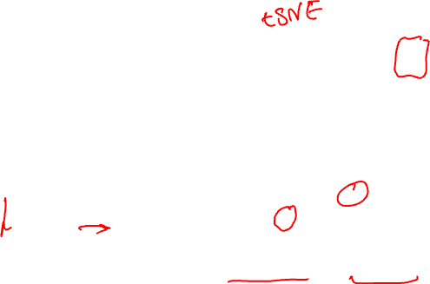
ML and electronic healthcare records analysis
Source: J. Li et al., under review, 2024.
Other examples: Morin, O., Vallières, M., Braunstein, S. et al. An artificial intelligence framework integrating longitudinal electronic health records with real-world data enables continuous pan-cancer prognostication. Nat Cancer 2, 709–722 (2021). https://doi.org/10.1038/s43018-021-00236-2

Slide 20
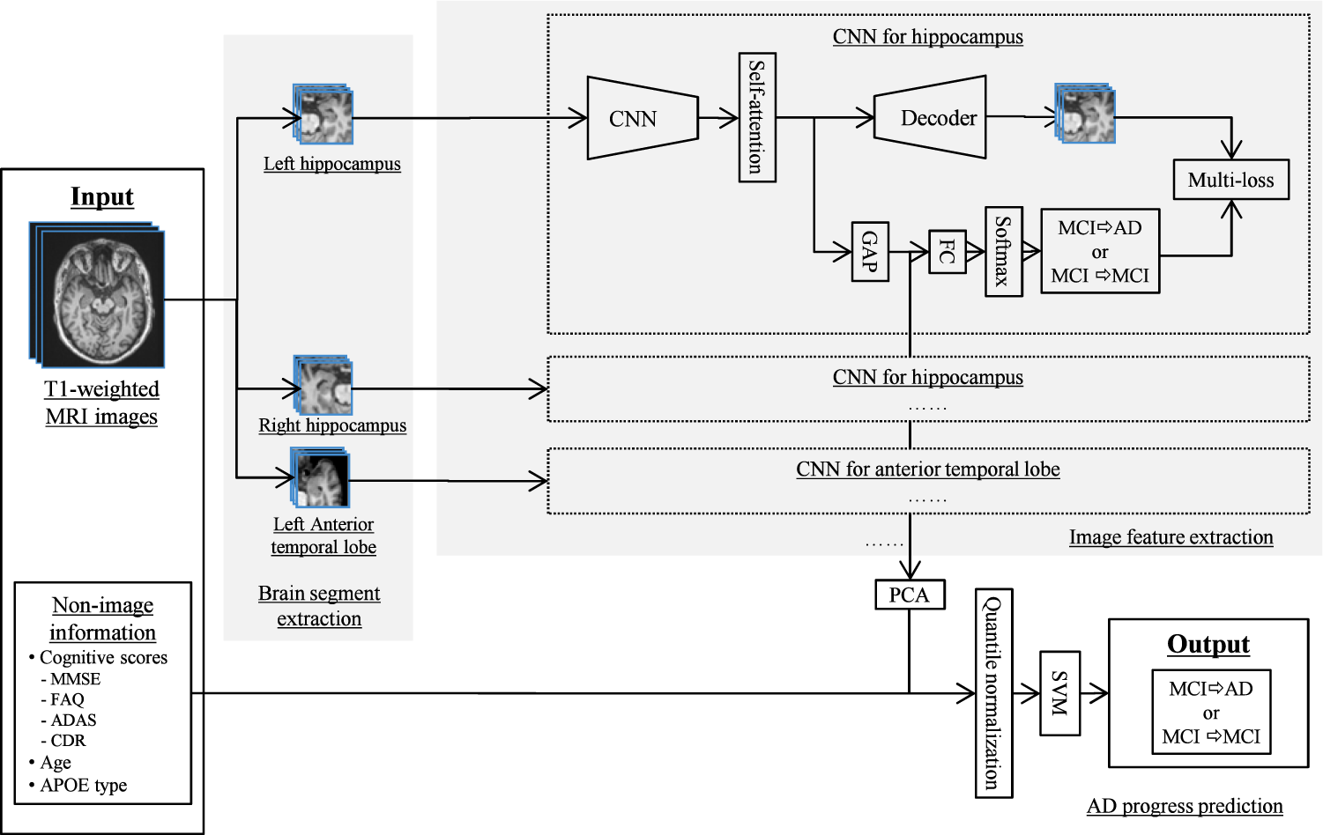

ML for predicting the progression of disease
Wang, C., Li, Y., Tsuboshita, Y. et al. A high-generalizability machine learning framework for predicting the progression of Alzheimer’s disease using limited data.npj Digit. Med. 5, 43 (2022).

Slide 21
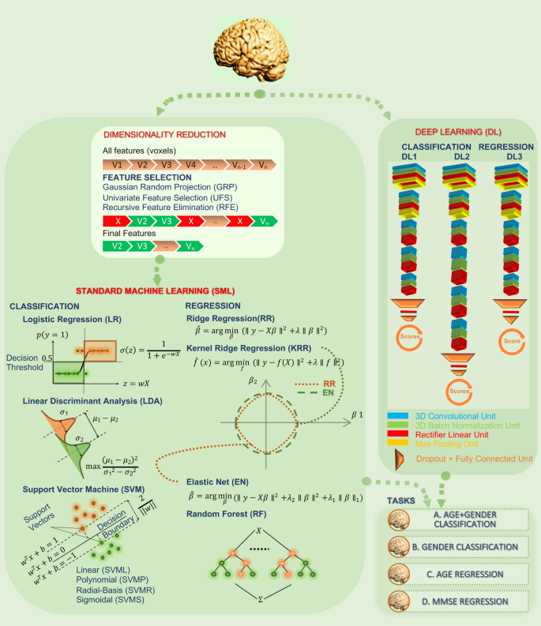

Neuroimaging and deep learning
Source: Abrol, A., Fu, Z., Salman, M. et al. Deep learning encodes robust discriminative neuroimaging representations to outperform standard machine learning. Nat Commun 12, 353 (2021).

Slide 22
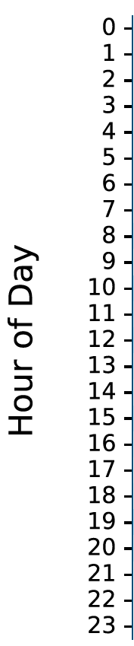
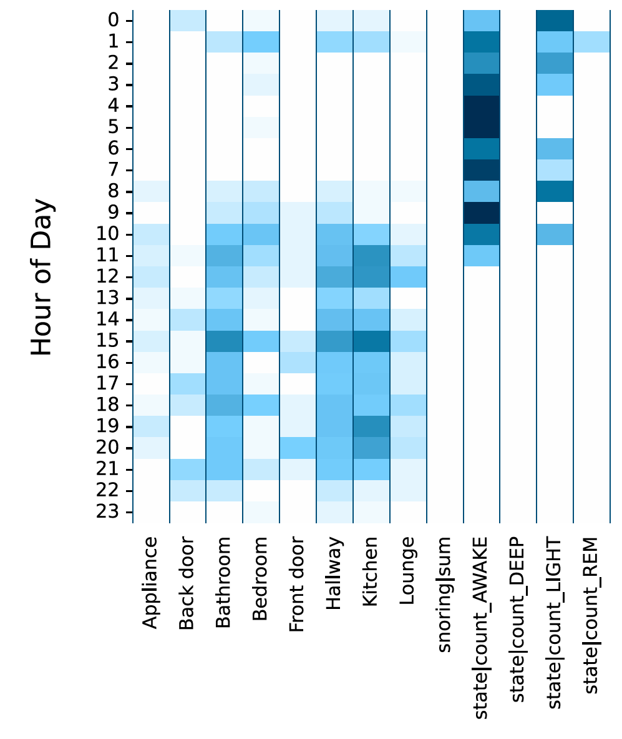
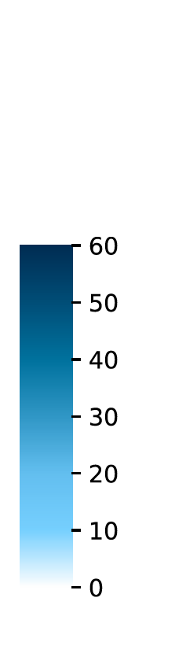
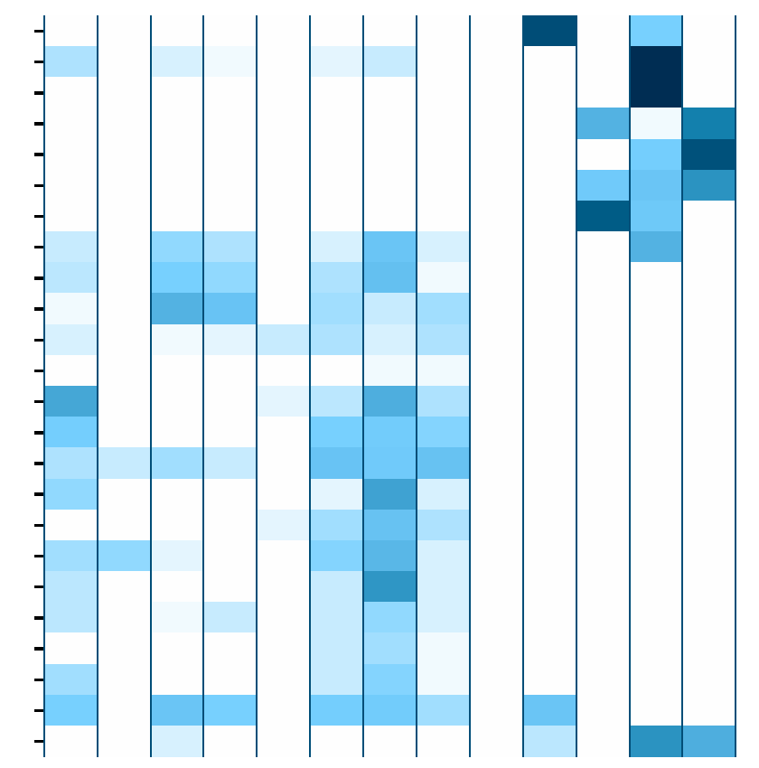
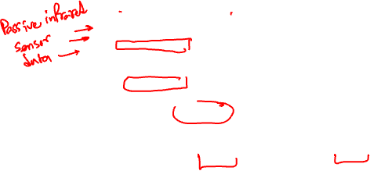
ML in precision health and care
UTIs are one of the top 5 reasons on unplanned hospital admissions in People Living with Dementia. UTI symptoms include increase in frequency of going to bathroom, delirium, increased temperature.
The model uses 20,738 person-days of in-home monitoring data which consists sleep, movement, and physiology data collected within the UK DRI CR&T study cohort (n=108) between 06/2021-07/2022.
Alex Capstick et al., npj Digital Medicine, 2024.

Slide 23
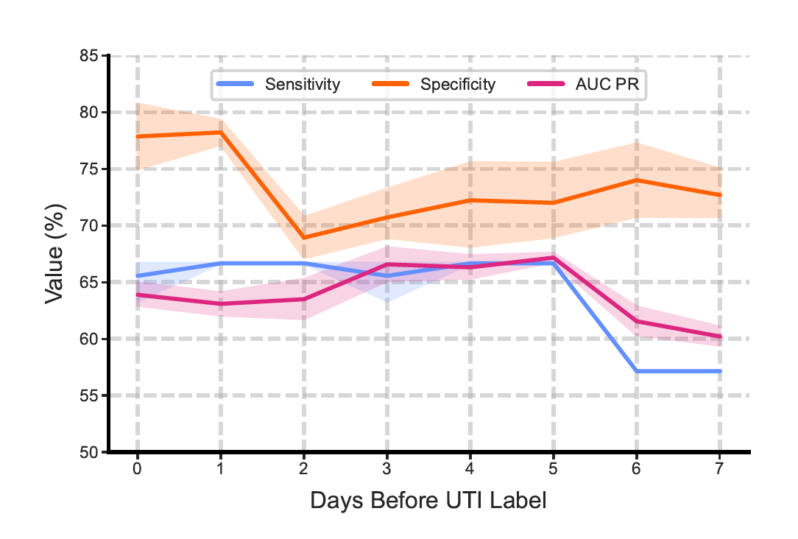
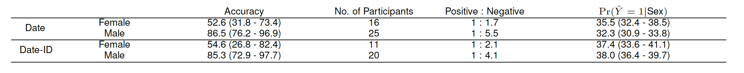
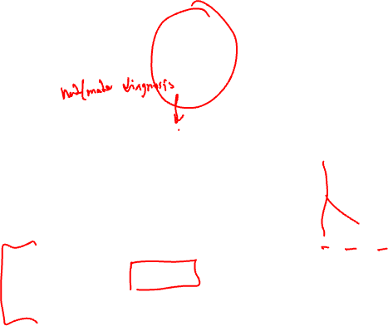
UTI risk analysis

Slide 24
Some other practical/useful methods and techniques

Slide 25
Principal component analysis (PCA)
PCA is used to decompose a multivariate dataset in a set of successive orthogonal components that explain a maximum amount of the variance.
In scikit-learn, PCA is implemented as a transformer object that learns n components in its fit method and can be used on new data to project it on these components.
Source: George Dallas, Principal Component Analysis 4 Dummies: Eigenvectors, Eigenvalues and Dimension Reduction.

Slide 26
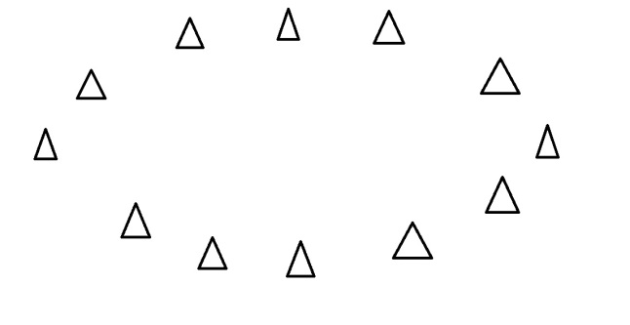
What are principal components?
They are the underlying structure in the data.
They are the directions where there is the most variance, the directions where the data is most spread out.
Source: George Dallas, Principal Component Analysis 4 Dummies: Eigenvectors, Eigenvalues and Dimension Reduction.

Slide 27
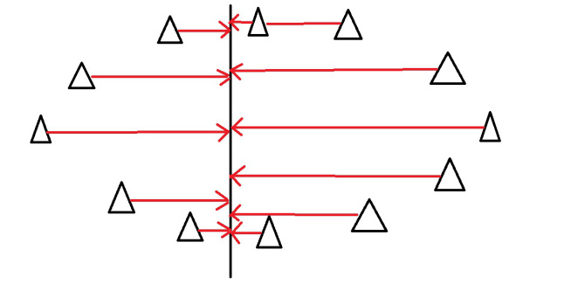
Direction where there is most variance
Imagine that the triangles are points of data. To find the direction where there is most variance, find the straight line where the data is most spread out when projected onto it. A vertical straight line with the points projected on to it will look like this:
Source: George Dallas, Principal Component Analysis 4 Dummies: Eigenvectors, Eigenvalues and Dimension Reduction.

Slide 28

PCA
Image source: Zakaria Jaadi, Builtin.com, https://builtin.com/data-science/step-step-explanation-principal-component-analysis

Slide 29
Eigenvectors and eigenvalues
Eigenvectors and values exist in pairs: every eigenvector has a corresponding eigenvalue.
An eigenvector is a direction, in the previous example the eigenvector was the direction of the line (vertical, horizontal, 45 degrees etc.).
An eigenvalue is a number, telling you how much variance there is in the data in that direction.
In the previous example the eigenvalue is a number telling us how spread out the data is on the line. The eigenvector with the highest eigenvalue is therefore the principal component.
Source: George Dallas, Principal Component Analysis 4 Dummies: Eigenvectors, Eigenvalues and Dimension Reduction.

Slide 30
Dimensions and eigenvectors
The number of eigenvectors/values that exist equals the number of dimensions the data set has.
For example, if we measuring age and hours on the internet. there are 2 variables, it’s a 2-dimensional data set, therefore there are 2 eigenvectors/values.
If we measure age, hours on internet and hours on mobile phone there’s 3 variables, 3-D data set, so 3 eigenvectors/values.
The reason for this is that eigenvectors put the data into a new set of dimensions, and these new dimensions have to be equal to the original number of dimensions.
Source: George Dallas, Principal Component Analysis 4 Dummies: Eigenvectors, Eigenvalues and Dimension Reduction.

Slide 31
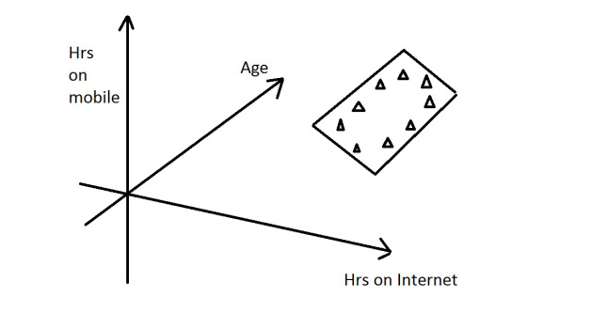
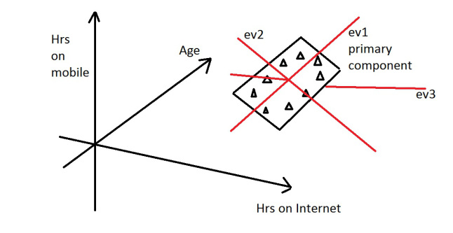
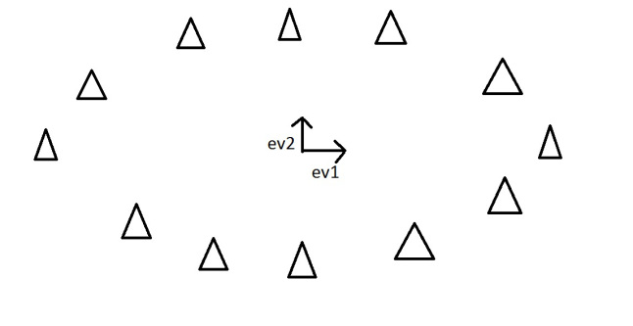
Dimension Reduction
PCA can be used to reduce the dimensions of a data set.
Dimension reduction reduces the data down into its basic components, stripping away any unnecessary parts.
Source: George Dallas, Principal Component Analysis 4 Dummies: Eigenvectors, Eigenvalues and Dimension Reduction.

Slide 32
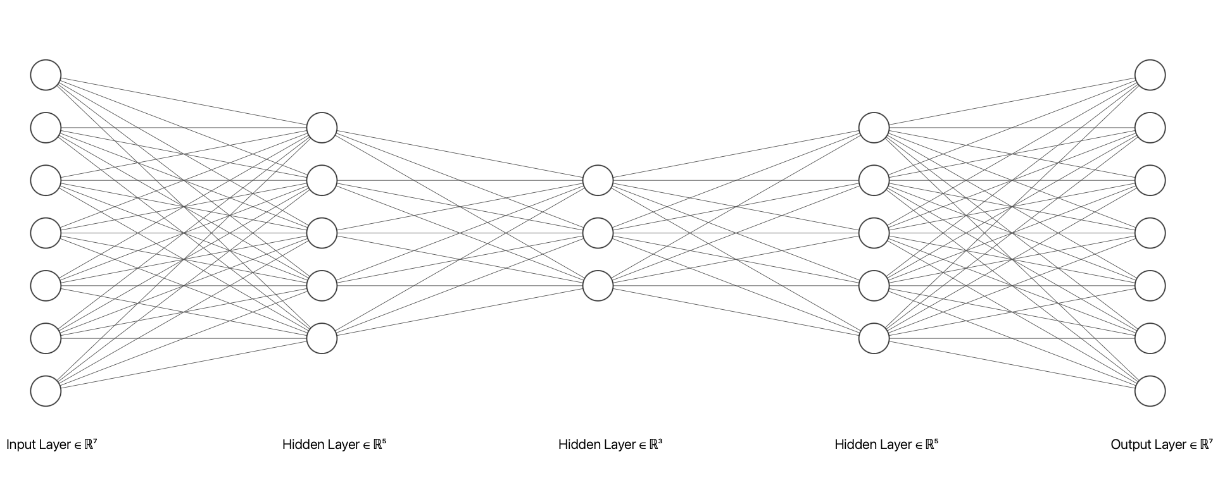
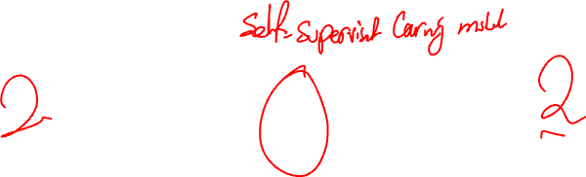
Deep Autoencoders
A typical autoencoder consists of an encoder and a decoder.
The encoder projects the input to hidden representations and the decoder maps the hidden layer to the reconstruction layer.

Slide 33

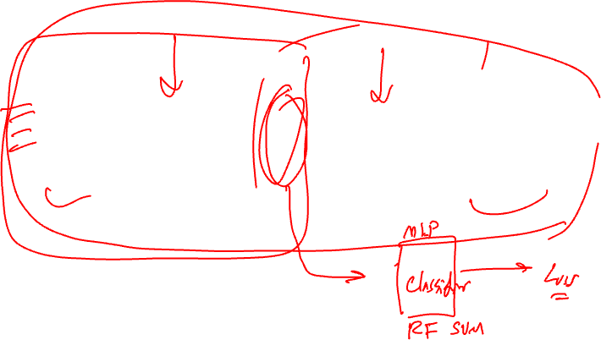
Autoencoder example
Source: https://blog.keras.io/building-autoencoders-in-keras.html

Slide 34
Autoencoders
"Autoencoding" is a data representation algorithm in lower dimension where the encoding and decoding functions:
data-specific
lossy,
learned automatically from examples rather than engineered by a human.
Additionally, in almost all contexts where the term "autoencoder" is used, the encoder and decoder functions are implemented with neural networks.
Adapted from: https://blog.keras.io/building-autoencoders-in-keras.html

Slide 35
Autoencoders
Practical applications of autoencoders include data denoising , and dimensionality reduction.
With appropriate dimensionality and sparsity constraints, autoencoders can learn data projections that are more efficient than PCA or other basic techniques.
Adapted from: https://blog.keras.io/building-autoencoders-in-keras.html

Slide 36
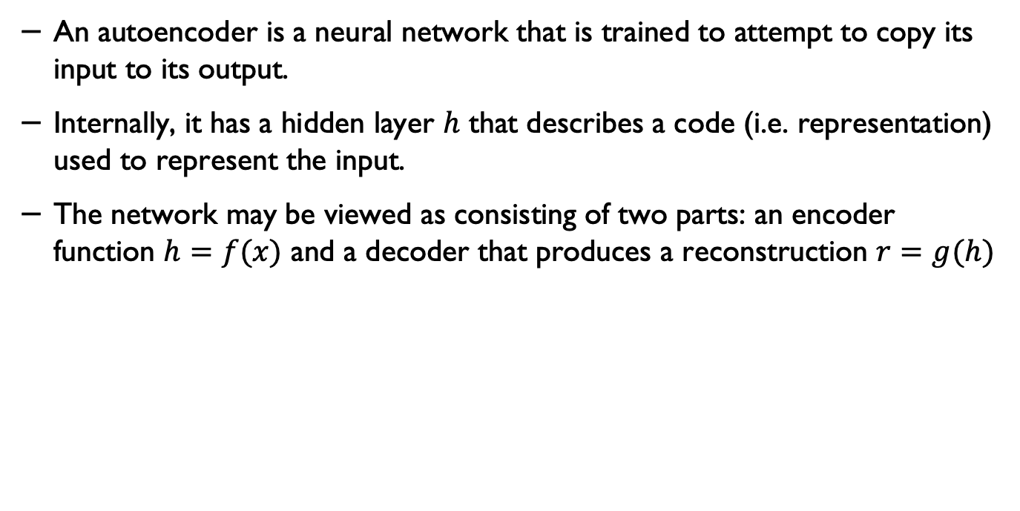
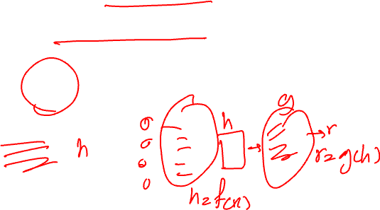
In other words
An autoencoder is a neural network that is trained to attempt to copy its input to its output.
Internally, it has a hidden layer $h$ that describes a code (i.e. representation) used to represent the input.
The network may be viewed as consisting of two parts: an encoder function $h=f(x)$ and a decoder that produces a reconstruction $r=g(h)$
Source: Ian Goodfellow et al., Deep Learning, MIT Press, 2016. http://www.deeplearningbook.org

Slide 37
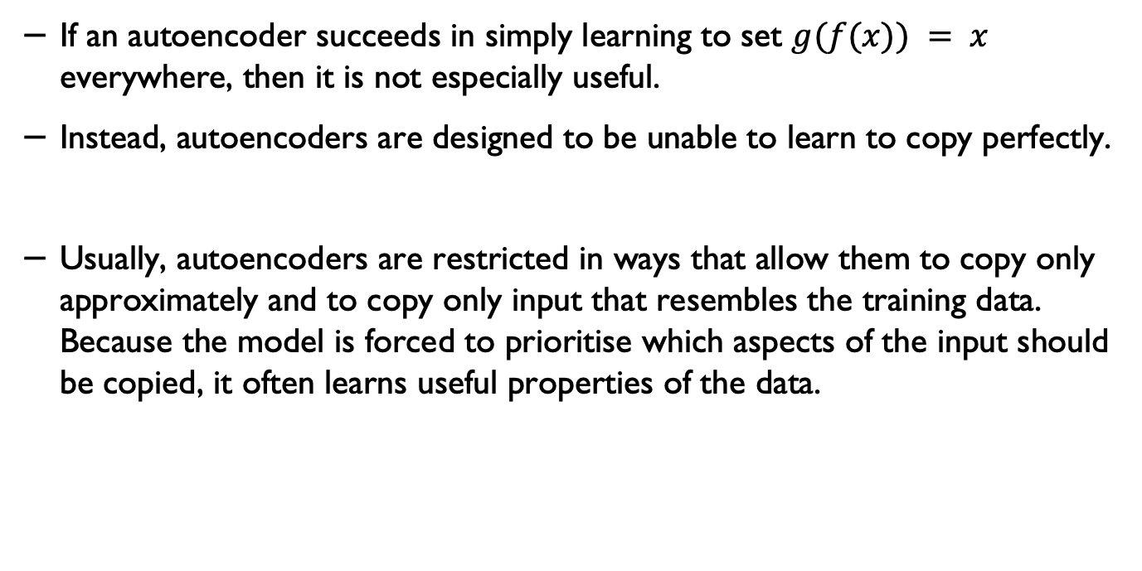
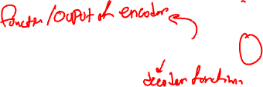
Important note on autoencoders
If an autoencoder succeeds in simply learning to set $g(f(x)) = x$ everywhere, then it is not especially useful.
Instead, autoencoders are designed to be unable to learn to copy perfectly.
Usually, autoencoders are restricted in ways that allow them to copy only approximately and to copy only input that resembles the training data. Because the model is forced to prioritise which aspects of the input should be copied, it often learns useful properties of the data.
Source: Ian Goodfellow et al., Deep Learning, MIT Press, 2016. http://www.deeplearningbook.org

Slide 38
Dropouts in autoencoders
You can add dropout to reduce overfitting.

Slide 39
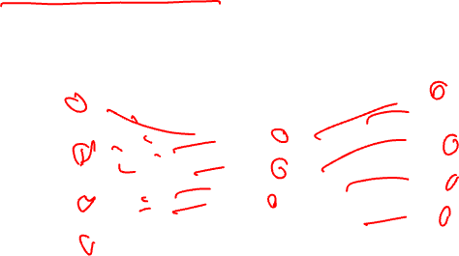
Undercomplete representation
An autoencoder whose code dimension is less than the input dimension is called undercomplete.
Learning an undercomplete representation forces the autoencoder to capture the most salient features of the training data

Slide 40
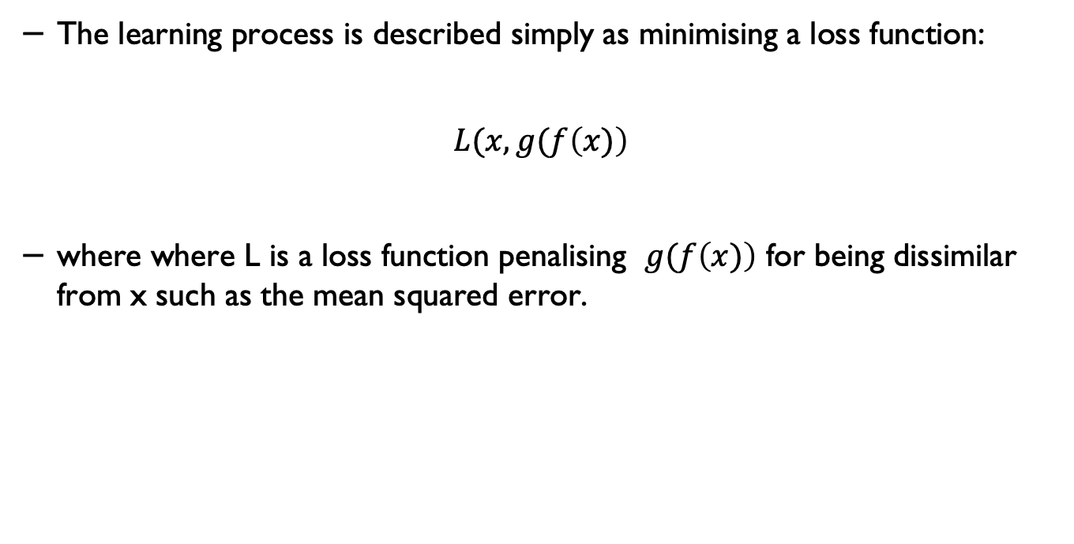
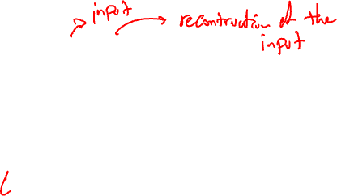
Learning process in autoencoders
The learning process is described simply as minimising a loss function:
$$L(x, g(f\left(x)\right)$$
where where L is a loss function penalising $g(f\left(x)\right)$ for being dissimilar from x such as the mean squared error.
Source: Ian Goodfellow et al., Deep Learning, MIT Press, 2016. http://www.deeplearningbook.org

Slide 41
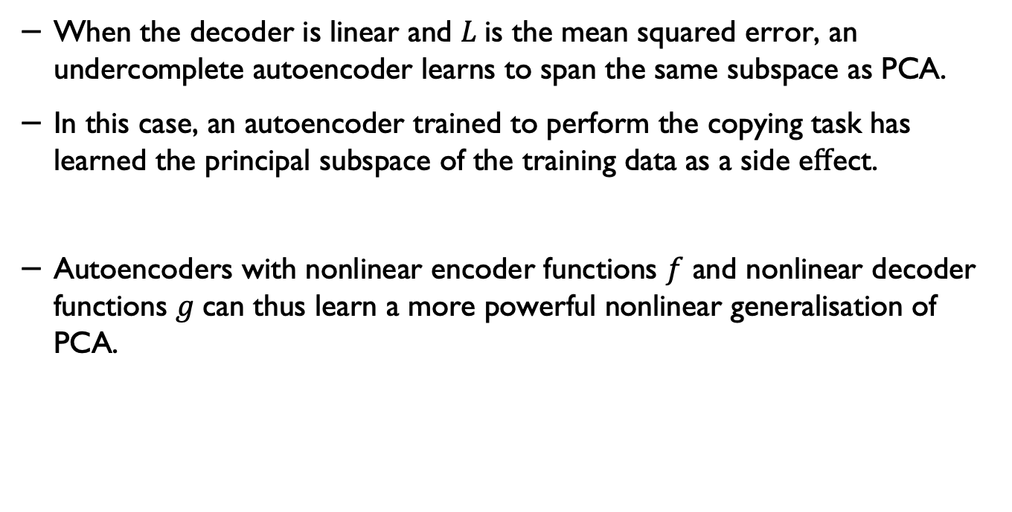
Linear decoders
When the decoder is linear and $L$is the mean squared error, an undercomplete autoencoder learns to span the same subspace as PCA.
In this case, an autoencoder trained to perform the copying task has learned the principal subspace of the training data as a side eﬀect.
Autoencoders with nonlinear encoder functions $f$ and nonlinear decoder functions $g$can thus learn a more powerful nonlinear generalisation of PCA.
Source: Ian Goodfellow et al., Deep Learning, MIT Press, 2016. http://www.deeplearningbook.org

Slide 42

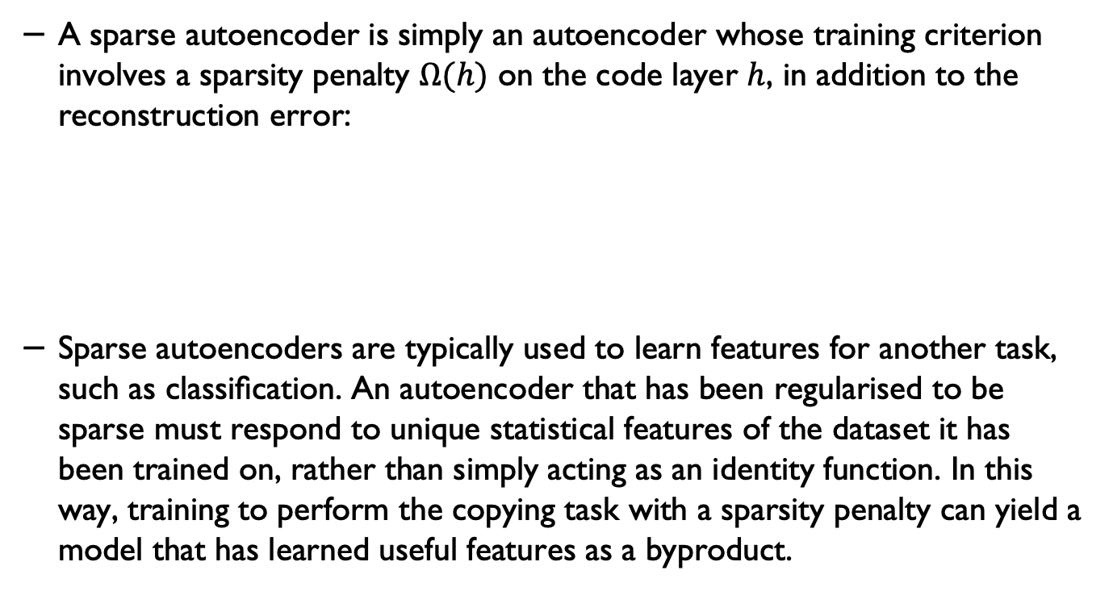
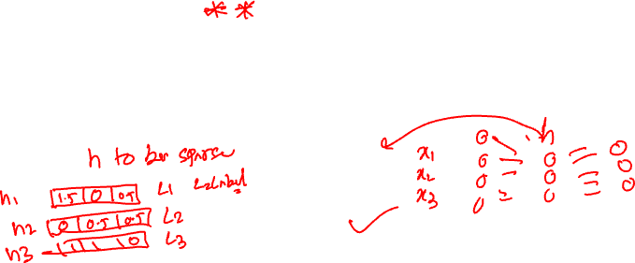
Sparse autoencoders
A sparse autoencoder is simply an autoencoder whose training criterion involves a sparsity penalty $Ω(h)$ on the code layer $h$, in addition to the reconstruction error:
Sparse autoencoders are typically used to learn features for another task, such as classiﬁcation. An autoencoder that has been regularised to be sparse must respond to unique statistical features of the dataset it has been trained on, rather than simply acting as an identity function. In this way, training to perform the copying task with a sparsity penalty can yield a model that has learned useful features as a byproduct.
$$L(x, g(f\left(x)\right)+ Ω(h)$$
Source: Ian Goodfellow et al., Deep Learning, MIT Press, 2016. http://www.deeplearningbook.org

Slide 43
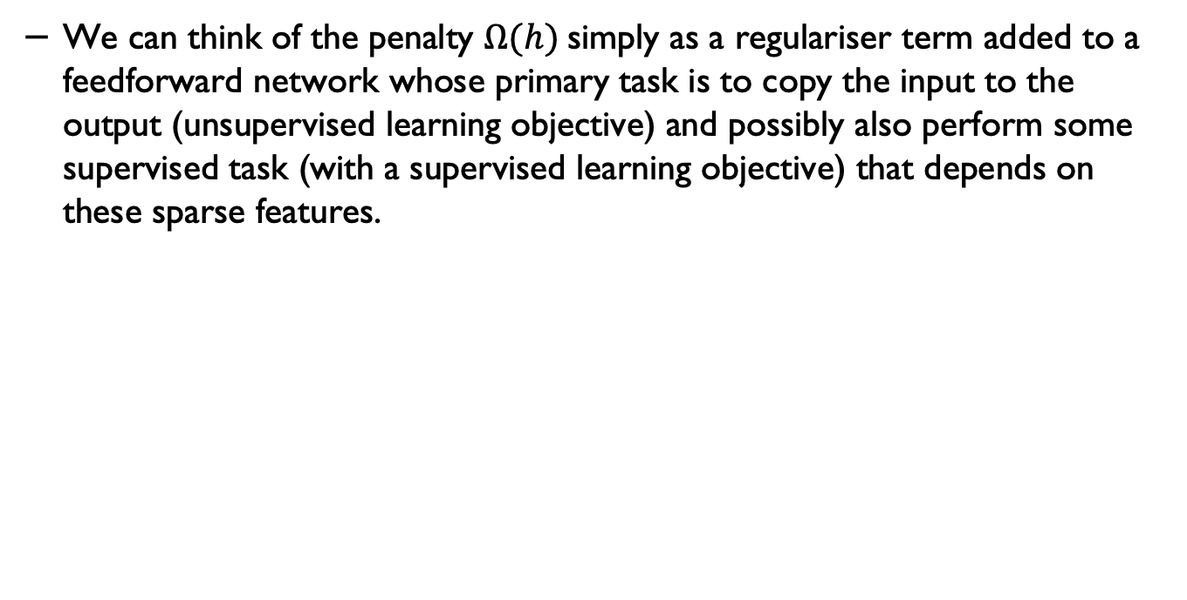
Sparse autoencoders
We can think of the penalty $Ω(h)$ simply as a regulariser term added to a feedforward network whose primary task is to copy the input to the output (unsupervised learning objective) and possibly also perform some supervised task (with a supervised learning objective) that depends on these sparse features.
Source: Ian Goodfellow et al., Deep Learning, MIT Press, 2016. http://www.deeplearningbook.org

Slide 44
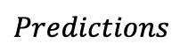
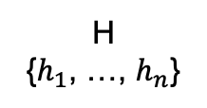
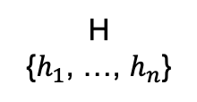
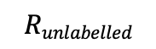
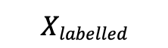
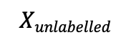
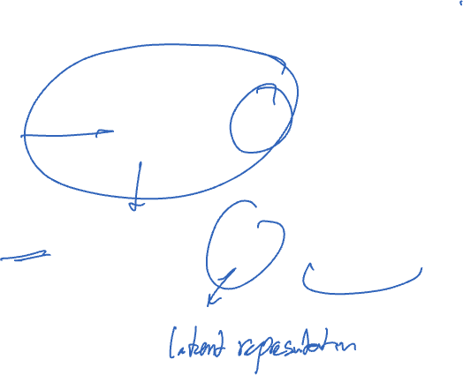
A semi-supervised learning scenario
Encoder
H
{$h_{1}$, …, $h_{n}$}
Decoder
$$Xunlabelled$$
$$Runlabelled$$
Encoder
H
{$h_{1}$, …, $h_{n}$}
$$Xlabelled$$
Classifier
$$Predictions$$

Slide 45
Encoding categorical features
Often features are not given as continuous values but categorical.
For example a person could have features ["male", "female"], [”low", ”mild” ”high", ”severe"]..
Such features can be efficiently coded as integers, for instance ["male",”has low symptoms"] could be expressed as [0, 1] while ["female", ”has severe"] would be [1, 4].
Such integer representation often cannot be used directly with machine learning models.

Slide 46

Encoding categorical features
Such integer representation cannot be used directly with machine learning models that expect continuous input, and would interpret the categories as being ordered, which is often not desired (i.e. the set of browsers was ordered arbitrarily).
One possibility to convert categorical features to features that can be used with scikit-learn estimators is to use a one-of-K or one-hot encoding, which is implemented in OneHotEncoder.
This estimator transforms each categorical feature with m possible values into m binary features, with only one active.

Slide 47
Encoding categorical features
By default, how many values each feature can take is inferred automatically from the dataset.
It is possible to specify this explicitly using the parameter n_values.
There are two genders, three possible continents and four web browsers in our dataset. Then we fit the estimator and transform a data point.
In the result, the first two numbers encode the gender, the next set of three numbers the continent and the last four the web browser.

Slide 48
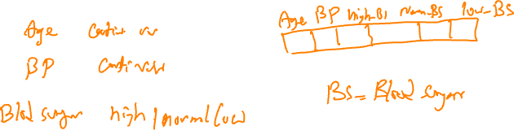
OneHotEncoder
The input to this transformer should be a matrix of integers, denoting the values taken on by categorical (discrete) features.
The output will be a sparse matrix where each column corresponds to one possible value of one feature.
It is assumed that input features take on values in the range [0, n_values).
This encoding is needed for feeding categorical data to many scikit-learn estimators, notably linear models and SVMs with the standard kernels.

Slide 49
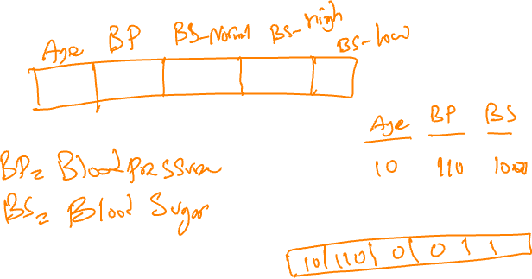
OneHotEncoder- example

Slide 50

Imputation of missing values
For various reasons, many real-world datasets contain missing values, often encoded as blanks, NA or other placeholders.
Such datasets however are incompatible with scikit-learn estimators which assume that all values in an array are numerical, and that all have and hold meaning.
A basic strategy to use incomplete datasets is to discard entire rows and/or columns containing missing values.
However, this comes at the price of losing data which may be valuable (even though incomplete).
A better strategy is to impute the missing values, i.e., to infer them from the known part of the data.

Slide 51
The Imputer class (in Python)
The Imputer class provides basic strategies for imputing missing values, either using the mean, the median or the most frequent value of the row or column in which the missing values are located.
This class also allows for different missing values encodings.
strategy : string, optional (default=”mean”)
The imputation strategy.
If “mean”, then replace missing values using the mean along the axis.
If “median”, then replace missing values using the median along the axis.
If “most_frequent”, then replace missing using the most frequent value along the axis.

Slide 52
Data imputation
There are obviously other more sophisticated imputation techniques.
But the most important consideration is knowing the data, application context and the techniques and solutions that would be more relevant to the given data/context and those that won’t add more bias to the data.

Slide 53
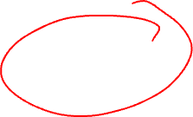
Feature selection
The classes in the sklearn.feature_selection module can be used for feature selection/dimensionality reduction on sample sets, either to improve estimators’ accuracy scores or to boost their performance on very high-dimensional datasets.

Slide 54

Removing features with low variance
VarianceThreshold is a simple baseline approach to feature selection.
It removes all features whose variance doesn’t meet some threshold. By default, it removes all zero-variance features, i.e. features that have the same value in all samples.
There are several other methods/techniques and models for feature selection. We will/have studied some of those in this series.

Slide 55
Some of the topics that we didn’t cover in this module
(some of these will be covered in the optional series in March/April)

Slide 56
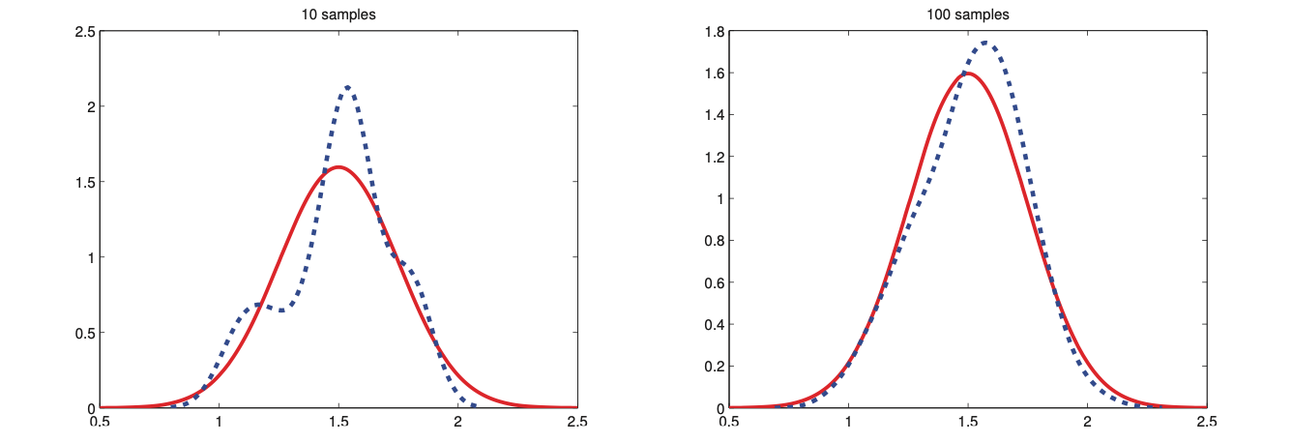

Sampling and Monte Carlo methods
Image source: Kevin Murphy, Machine Learning: A probabilistic perspective
Example work on healthcare applications, Pourshahrokhi et al., https://arxiv.org/pdf/2103.02349.pdf

Slide 57
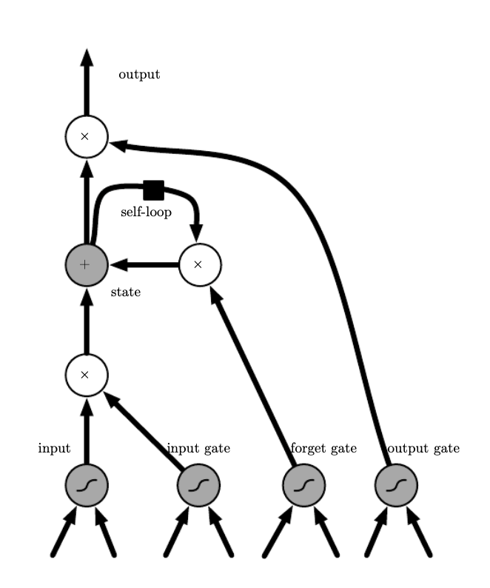

Recurrent models
A view of Long Short Term Memory (LSTM) model
Image source: Ian Goodfellow et al., Deep Learning, MIT Press, 2016. http://www.deeplearningbook.org

Slide 58
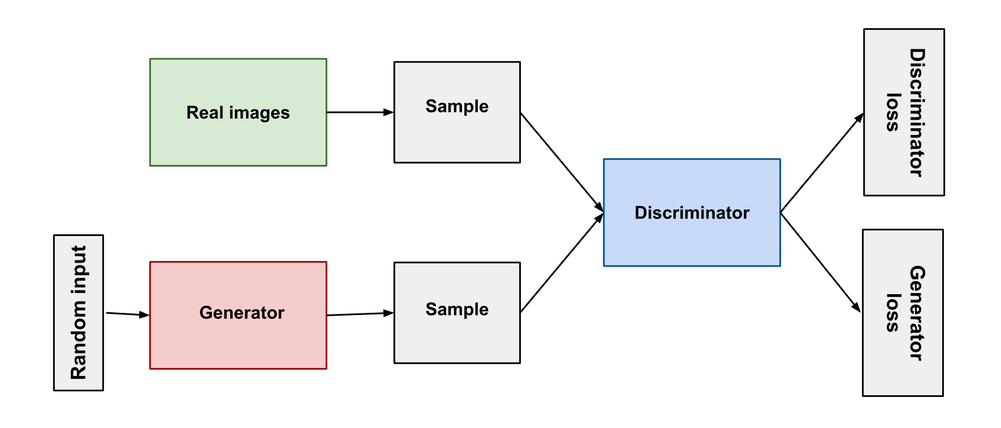

Generative Adversarial Networks
Both the generator and the discriminator are neural networks.
The generator output is connected directly to the discriminator input. Through backpropagation, the discriminator's classification provides a signal that the generator uses to update its weights.
Source: https://developers.google.com/machine-learning/gan/gan_structure

Slide 59


Diffusion models
Source: Understanding Deep Learning, Simon J.D. Prince, MIT Press.

Slide 60


Adversarial Examples
Can we change one pixel in an image to deceive a machine learning model?
Original paper: Su, Jiawei, Danilo Vasconcellos Vargas, and Kouichi Sakurai. "One pixel attack for fooling deep neural networks. "IEEE Transactions on Evolutionary Computation (2019)
Image source: https://christophm.github.io/interpretable-ml-book/adversarial.html

Slide 61


A linear adversarial example
A demonstration of fast adversarial example generation applied to GoogLeNet(Szegedy et al., 2014) on ImageNet.
Original paper: Explaining and Harnessing Adversarial Examples, Ian J. Goodfellow, Jonathon Shlens, Christian Szegedy,
https://arxiv.org/abs/1412.6572

Slide 62




Attention-based models and Transformers
Patient
Demographics/
diagnosis
Chloral hydrate
Paracetamol
Levetiracetam
FIB_low
PT_high
Left, Source: Vaswani et al., https://arxiv.org/pdf/1706.03762.pdf
Right, Image adapted from: Understanding Deep Learning, Simon J.D. Prince, MIT Press.
Pytorch tutorial: https://pytorch.org/tutorials/beginner/transformer_tutorial.html

Slide 63


Large Language Models (LLMs)
Source: Understanding Deep Learning, Simon J.D. Prince, MIT Press.

Slide 64
If you have any questions
Please feel free to arrange a meeting or email (p.barnaghi@imperial.ac.uk).
My office: 928, Sir Michael Uren Research Hub, White City Campus.

